Slide 1
OPTICAL SOURCES

Slide 2
Considerations with Optical Sources
Physical dimensions to suit the fiber
Narrow radiation pattern (beam width)
Linearity (output light power proportional to driving current)
Ability to be directly modulated by varying driving current
Fast response time (wide band)
Adequate output power into the fiber

Slide 3
Considerations…
Narrow spectral width (or line width)
Stability and efficiency
Driving circuit issues
Reliability and cost

Slide 4
Semiconductor Light Sources
A PN junction (that consists of direct band gap semiconductor materials) acts as the active or recombination region.
When the PN junction is forward biased, electrons and holes recombine either radiatively (emitting photons) or non-radiatively (emitting heat). This is simple LED operation.
In a LASER, the photon is further processed in a resonance cavity to achieve a coherent, highly directional optical beam with narrow linewidth.

Slide 5
LED vs. laser spectral width
Single-frequency laser (<0.04 nm)
Laser output is many times higher than LED output; they would not show on same scale
Standard laser (1-3 nm wide)
LED (30-50 nm wide)
Wavelength

Slide 6
Light-Emitting Diodes (LEDs)
For photonic communications requiring data rate 100-200 Mb/s with multimode fiber with tens of microwatts, LEDs are usually the best choice.
LED configurations being used in photonic communications:
Surface Emitters (Front Emitters)
Edge Emitters

Slide 7
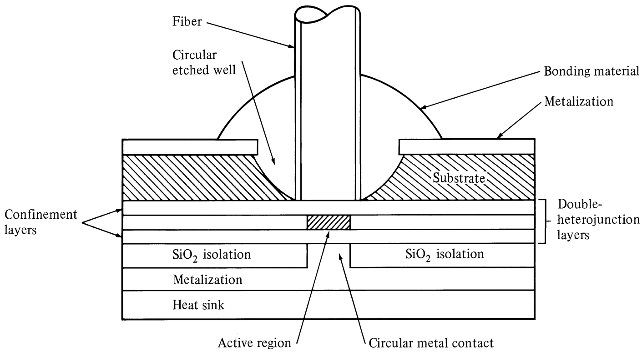
Surface-Emitting LED
Schematic of high-radiance surface-emitting LED. The active region is limitted
to a circular cross section that has an area compatible with the fiber-core end face.
Optical Fiber communications, 3rd ed.,G.Keiser,McGrawHill, 2000

Slide 8
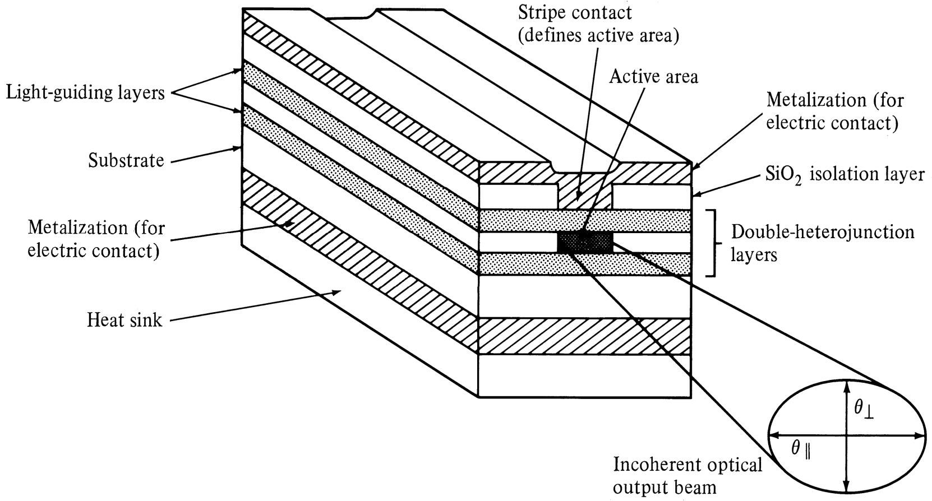
Edge-Emitting LED
Schematic of an edge-emitting double heterojunction LED. The output beam is
Lambertian in the plane of junction (θ = 120º) and highly directional perpendicular to
||
pn junction (θ⊥ = 30º) . They have high quantum efficiency & fast response.
Optical Fiber communications, 3rd ed.,G.Keiser,McGrawHill, 2000

Slide 9
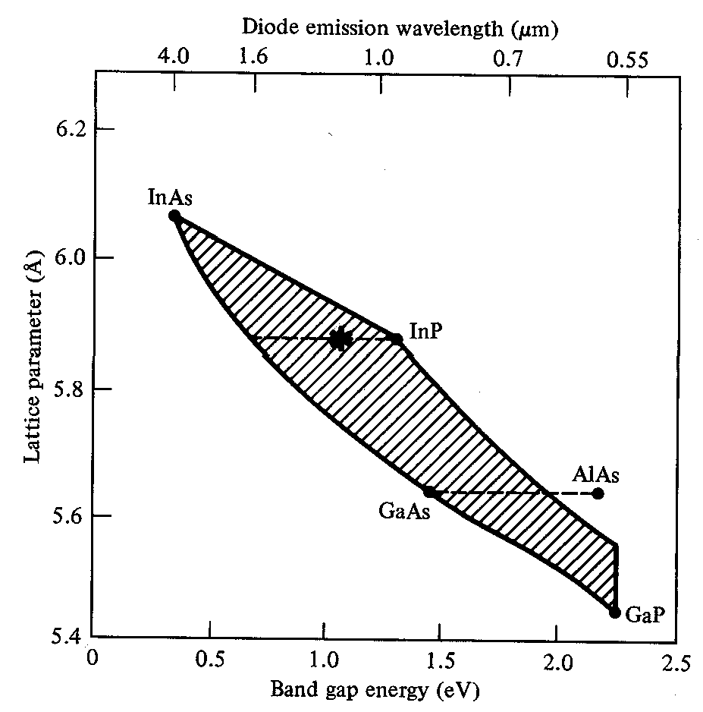
Optical Fiber communications, 3rd ed.,G.Keiser,McGrawHill, 2000

Slide 10
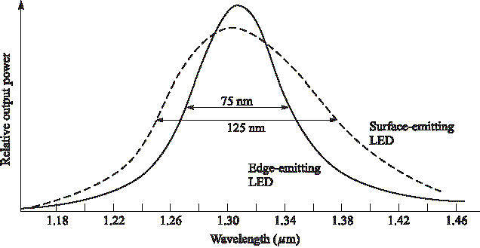
Spectral width of LED types
Optical Fiber communications, 3rd ed.,G.Keiser,McGrawHill, 2000

Slide 11
Drawbacks & Advantages of LED
Drawbacks
Large line width (30-40 nm)
Large beam width (Low coupling to the fiber)
Low output power
Low E/O conversion efficiency
Advantages
Robust
Linear

Slide 12
LASER
(Light Amplification by the Stimulated Emission of Radiation)
Laser is an optical oscillator. It comprises a resonant optical amplifier whose output is fed back into its input with matching phase. Any oscillator contains:
An amplifier with a gain-saturated mechanism
A feedback system
A frequency selection mechanism
An output coupling scheme
In laser, the amplifier is the pumped active medium, such as biased semiconductor region, feedback can be obtained by placing active medium in an optical resonator, such as Fabry- Perot structure, two mirrors separated by a prescribed distance. Frequency selection is achieved by resonant amplifier and by the resonators, which admits certain modes. Output coupling is accomplished by making one of the resonator mirrors partially transmitting.

Slide 13
Lasing in a pumped active medium
In thermal equilibrium the stimulated emission is essentially negligible, since the density of electrons in the excited state is very small, and optical emission is mainly because of the spontaneous emission. Stimulated emission will exceed absorption only if the population of the excited states is greater than that of the ground state. This condition is known as Population Inversion. Population inversion is achieved by various pumping techniques.
In a semiconductor laser, population inversion is accomplished by injecting electrons into the material to fill the lower energy states of the conduction band.

Slide 14
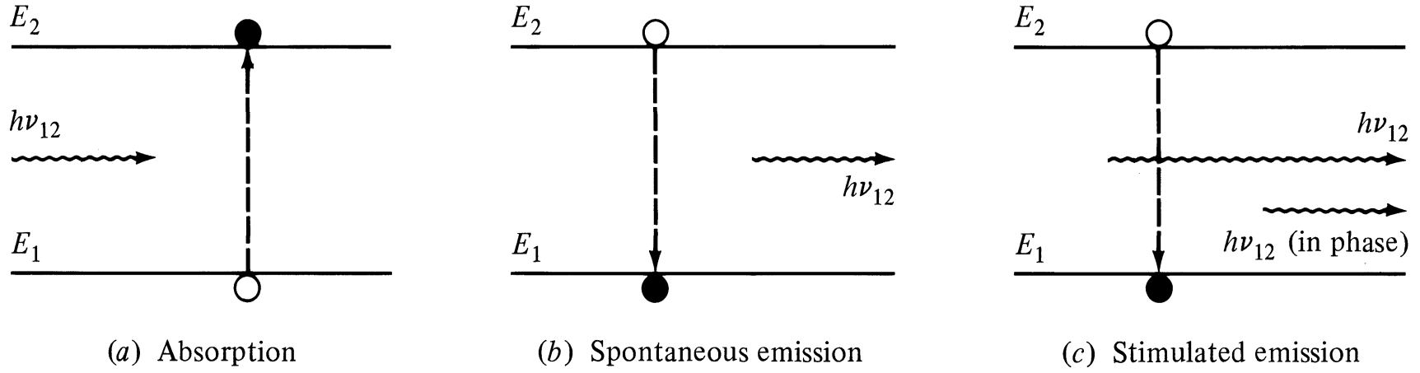
Pumped active medium
Three main process for laser action:
Photon absorption
Spontaneous emission
Stimulated emission
Energy absorbed from the incoming photon
Random release of energy
Coherent release of energy
Optical Fiber communications, 3rd ed.,G.Keiser,McGrawHill, 2000

Slide 15
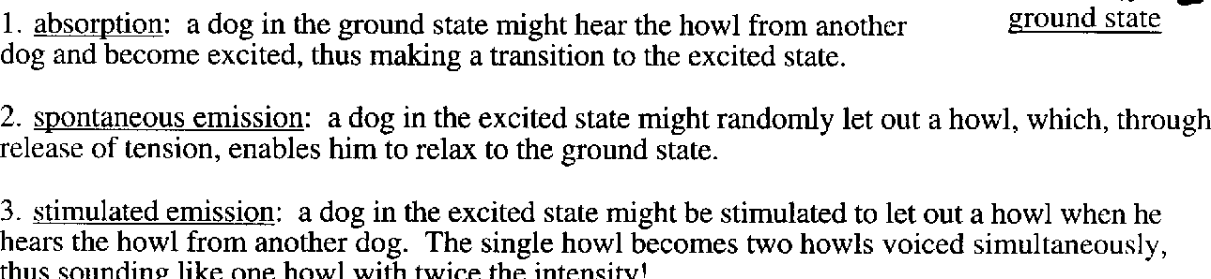
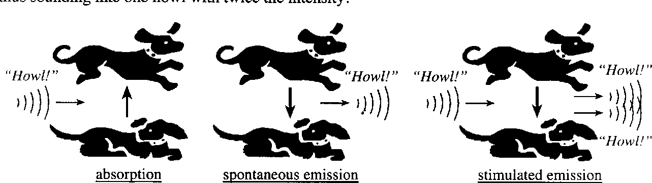
Howling Dog Analogy

Slide 16
In Stimulated Emission incident and stimulated photons will have
Identical energy 🡪 Identical wavelength 🡪 Narrow linewidth
Identical direction 🡪 Narrow beam width
Identical phase 🡪 Coherence and
Identical polarization

Slide 17
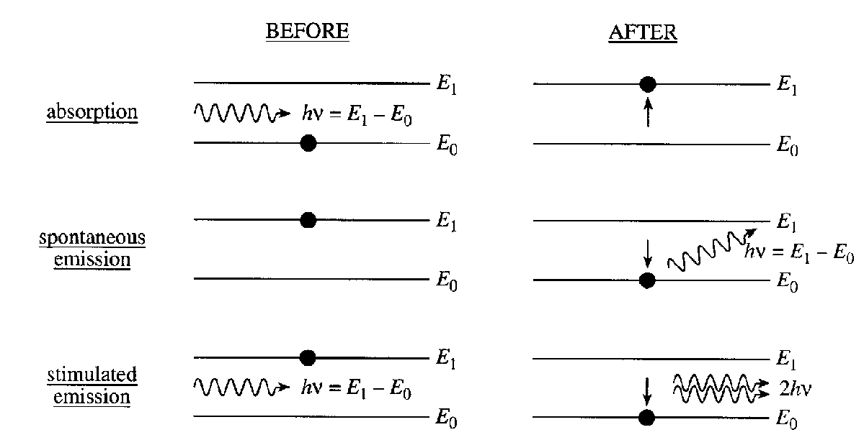
Stimulated Emission

Slide 18
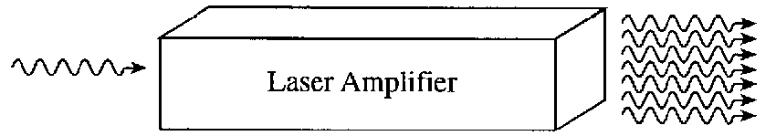
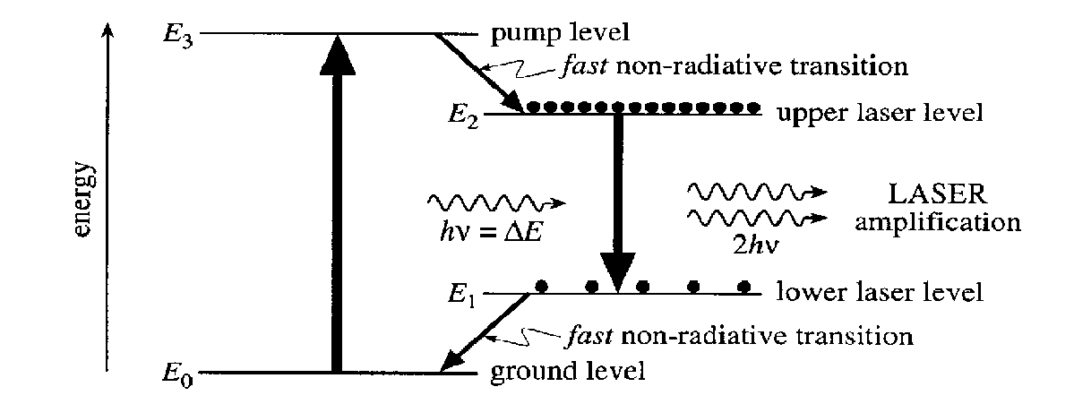

Slide 19


Fabry-Perot Resonator
M
M
Relative intensity
1
A
2
m = 1
υ_{f}
1
R ~ 0.8
m = 2
R ~ 0.4
δυ_{m}
B
L
m = 8
υ
^{υ}m - 1
υ_{m}
(c)
^{υ}m + 1
(a)
(b)
Resonant modes : kL = m m = 1,2,3,..
Schematic illustration of the Fabry-Perot optical cavity and its properties. (a) Reflected waves interfere. (b) Only standing EM waves, modes, of certain wavelengths are allowed in the cavity. (c) Intensity vs. frequency for various modes. R is mirror reflectance and lower R means higher loss from the cavity.
© 1999 S.O. Kasap, Optoelectronics (Prentice Hall)
(1− R)²
^{I}trans ^{= I}inc
[4-18]
(1− R)² + 4R sin ² (kL)
R: reflectance of the optical intensity, k: optical wavenumber

Slide 20
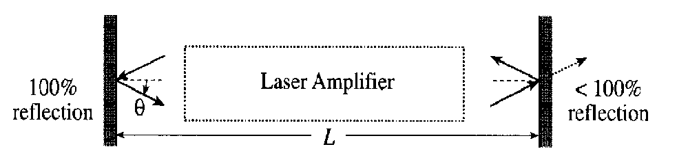
Mirror Reflections

Slide 21
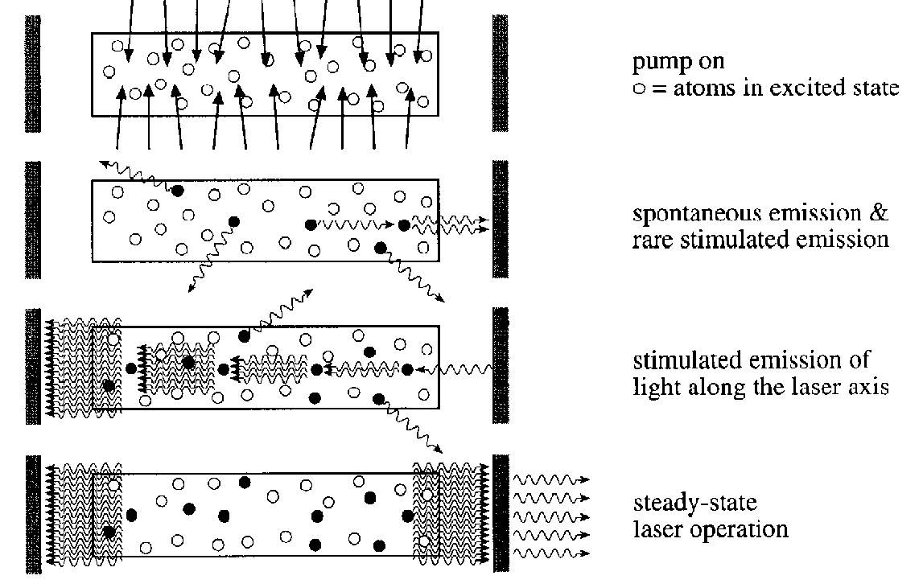
How a Laser Works

Slide 22
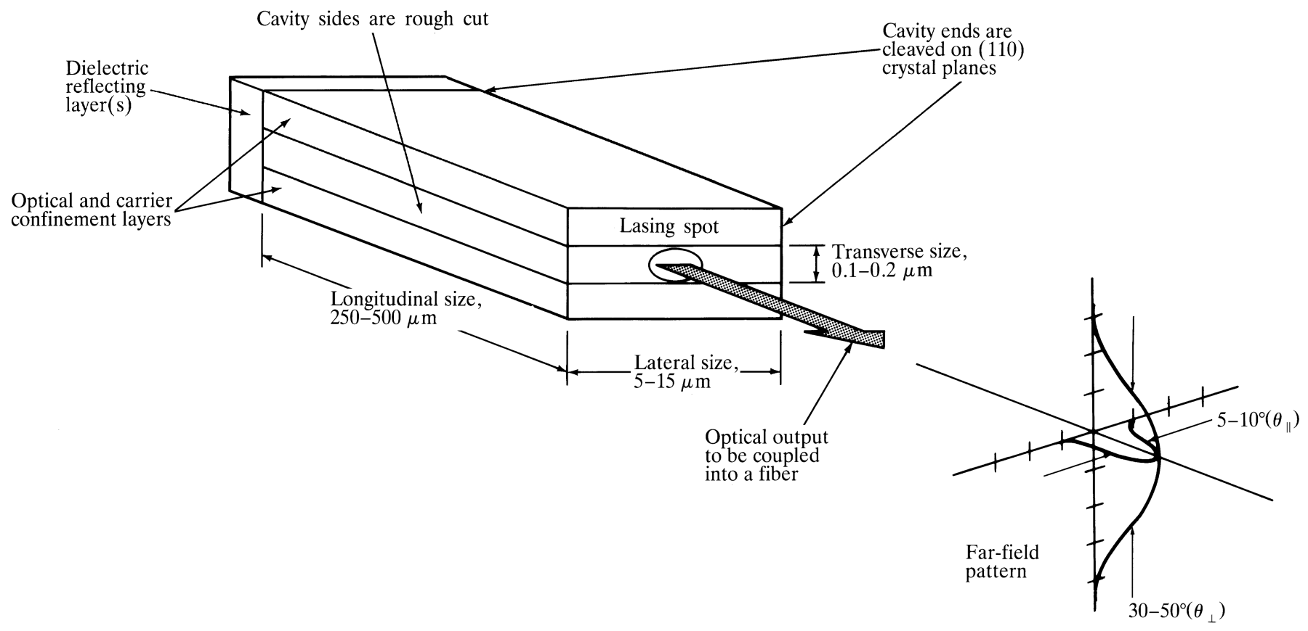
Laser Diode
Laser diode is an improved LED, in the sense that uses stimulated emission in semiconductor from optical transitions between distribution energy states of the valence and conduction bands with optical resonator structure such as Fabry-Perot resonator with both optical and carrier confinements.
Optical Fiber communications, 3rd ed.,G.Keiser,McGrawHill, 2000

Slide 23
Laser Diode Characteristics
Nanosecond & even picosecond response time (GHz BW)
Spectral width of the order of nm or less
High output power (tens of mW)
Narrow beam (good coupling to single mode fibers)
Laser diodes have three distinct radiation modes namely, longitudinal, lateral and transverse modes.
In laser diodes, end mirrors provide strong optical feedback in longitudinal direction, so by roughening the edges and cleaving the facets, the radiation can be achieved in longitudinal direction rather than lateral direction.

Slide 24
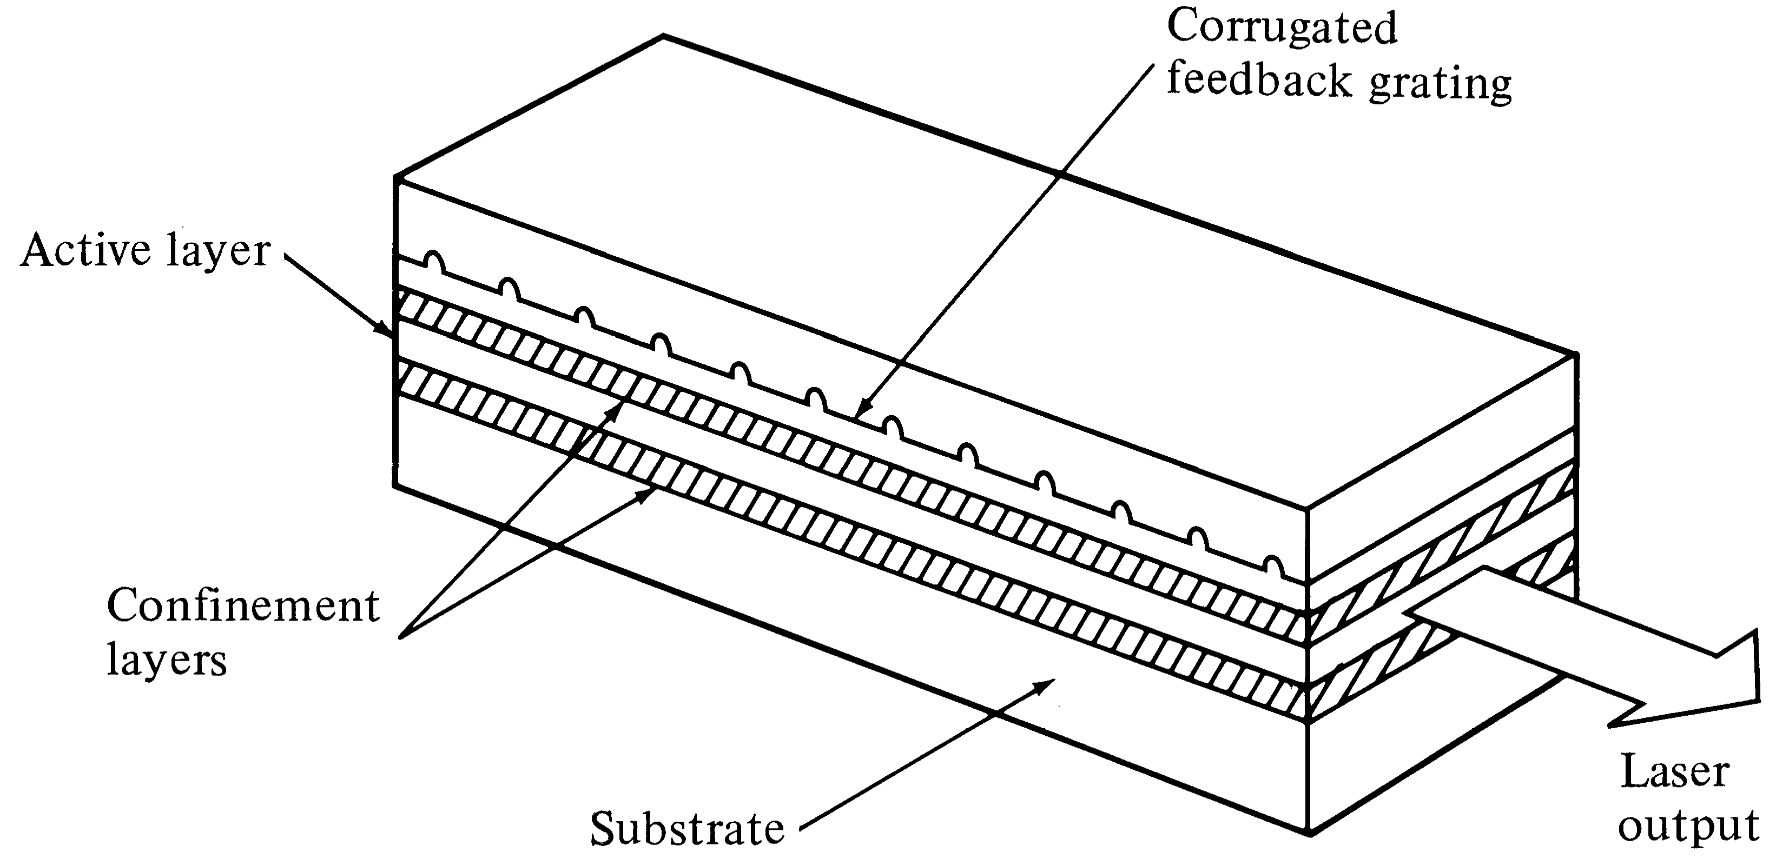
DFB(Distributed FeedBack) Lasers
In DFB lasers, the optical resonator structure is due to the incorporation of Bragg grating or periodic variations of the refractive index into multilayer structure along the length of the diode.
The optical feedback is provided by fiber Bragg Gratings
🡪 Only one wavelength get positive feedback
Optical Fiber communications, 3rd ed.,G.Keiser,McGrawHill, 2000

Slide 25
Laser Operation & Lasing Condition
To determine the lasing condition and resonant frequencies, we should focus on the optical wave propagation along the longitudinal direction, z-axis. The optical field intensity, I, can be written as:
I ( z, t ) = I ( z)e ^{j (ωt − βz )}
[4-19]
Lasing is the condition at which light amplification becomes possible by virtue of population inversion. Then, stimulated emission rate into a given EM mode is proportional to the intensity of the optical radiation in that mode. In this case, the loss and gain of the optical field in the optical path determine the
lasing condition. The radiation intensity of a photon at energy hν
varies exponentially with a distance z amplified by factor g, and attenuated by factor α according to the following relationship:

Slide 26
Single Mode Laser
Single mode laser is mostly based on the index- guided structure that supports only the fundamental transverse mode and the fundamental longitudinal mode. In order to make single mode laser we have four options:
Reducing the length of the cavity to the point where the frequency separation given in eq[4-31] of the adjacent modes is larger than the laser transition line width. This is hard to handle for fabrication and results in low output power.
Vertical-Cavity Surface Emitting laser (VCSEL)
Structures with built-in frequency selective grating
tunable laser diodes
.

Slide 27
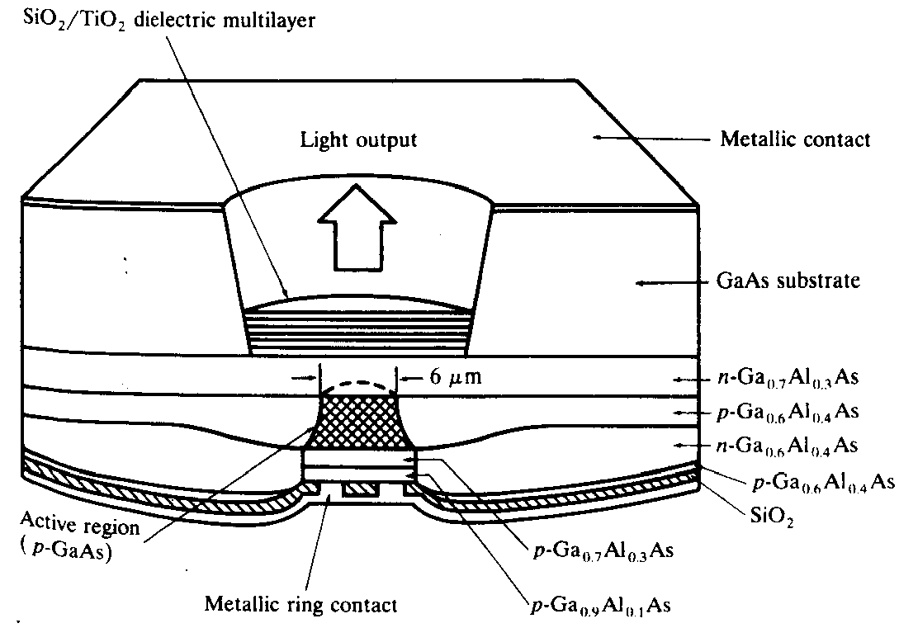
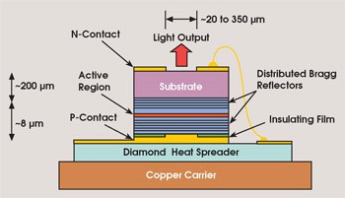
VCSEL

Slide 28
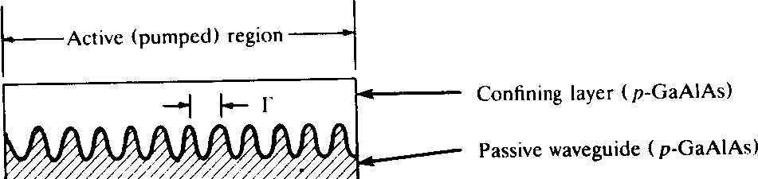
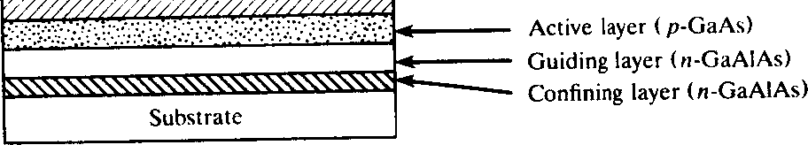
Frequency-Selective Laser Diodes: Distributed Feedback (DFB) Laser
Λ
2n_{e} Λ
Bragg wavelength
λ =
[4-33]
B
m
λ : effective refractive index; m : order of the grating
B

Slide 29
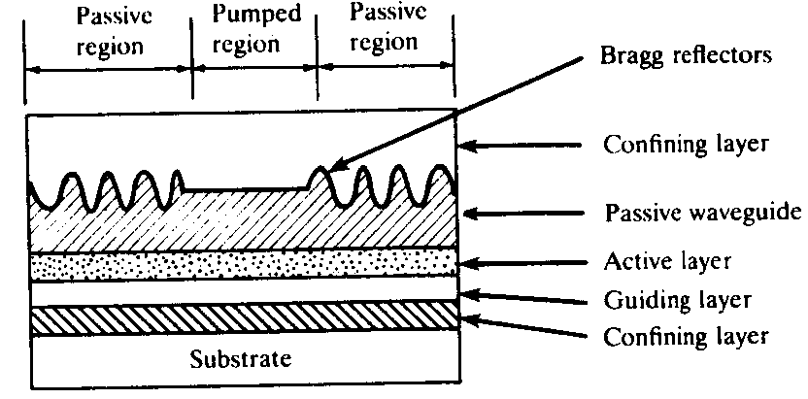
Frequency-Selective laser Diodes: Distributed Feedback Reflector (DBR) laser

Slide 30
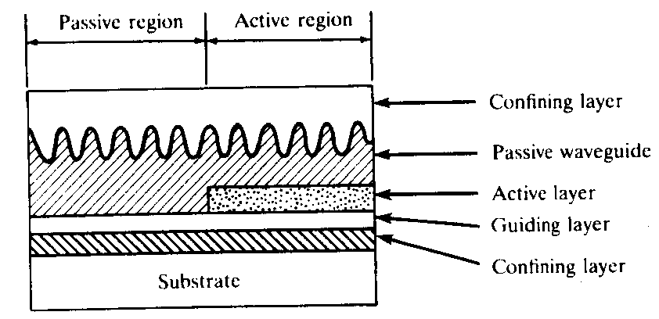
Frequency-Selective Laser Diodes: Distributed Reflector (DR) Laser

Slide 31
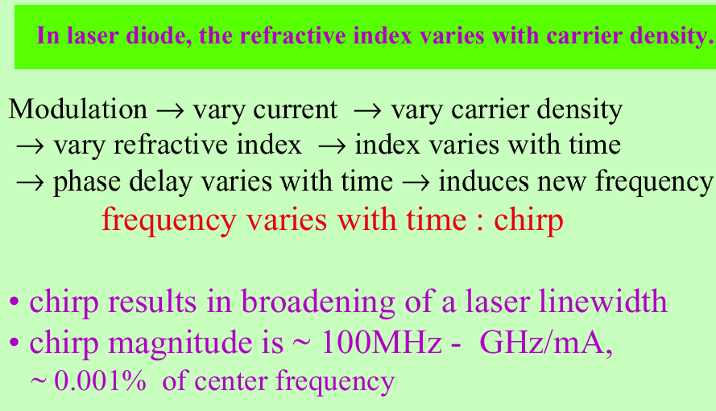
Chirp

Slide 32
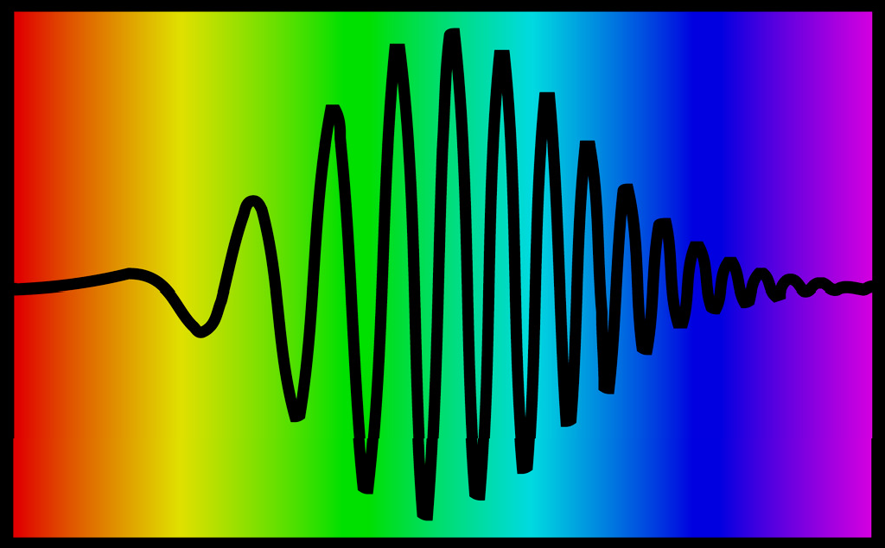
A pulse can have a frequency that varies in time.
This pulse increases its frequency linearly in time (from red to blue). In analogy to bird sounds, this pulse is called a "chirped" pulse.

Slide 33
External Optical Modulation
Laser Diode
EOM
Photo Detector
F ib re
RF
out
RF _{in}
L ink
Modulation and light generation are separated
Offers much wider bandwidth 🡪 up to 60 GHz
More expensive and complex
Used in high end systems

Slide 34
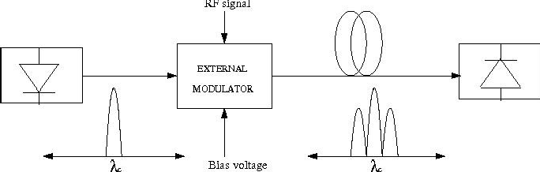
External Modulated Spectrum
Typical spectrum is double side band
However, single side band is possible which is useful at extreme RF frequencies

Slide 35
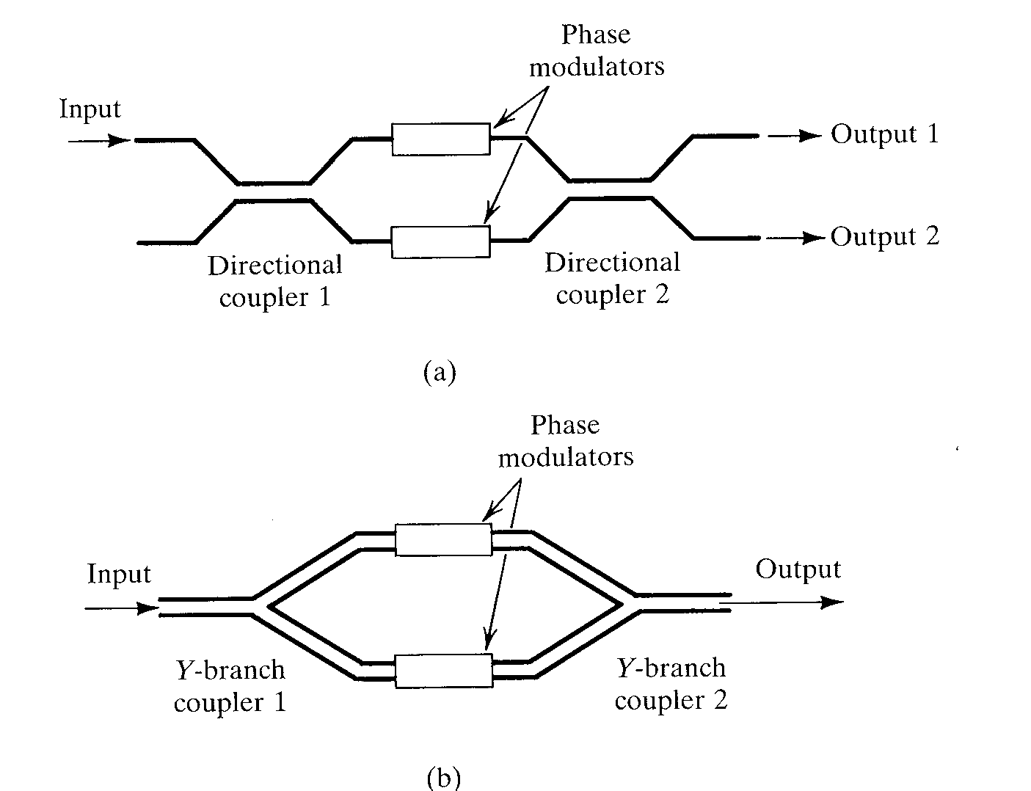
Mach-Zehnder Interferometers

Slide 36
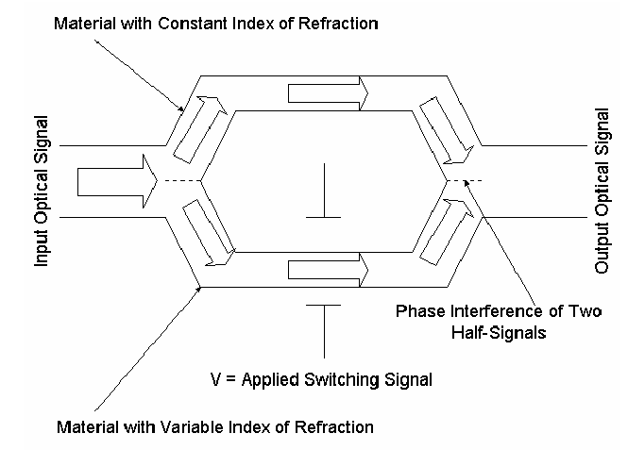
Mach- Zehnder modulator

Slide 37
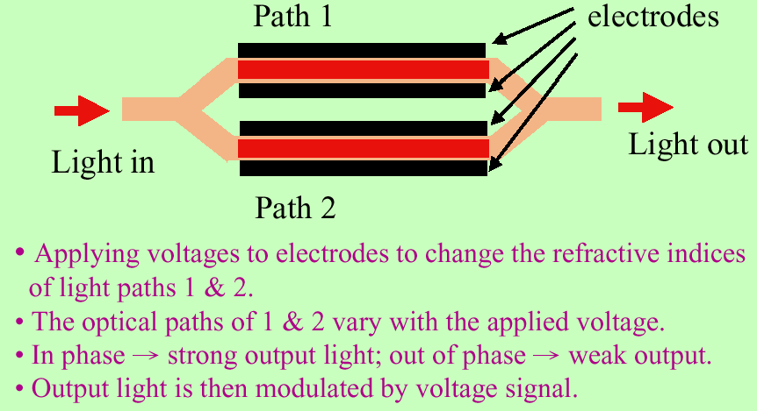
Mach- Zehnder modulator

Slide 38
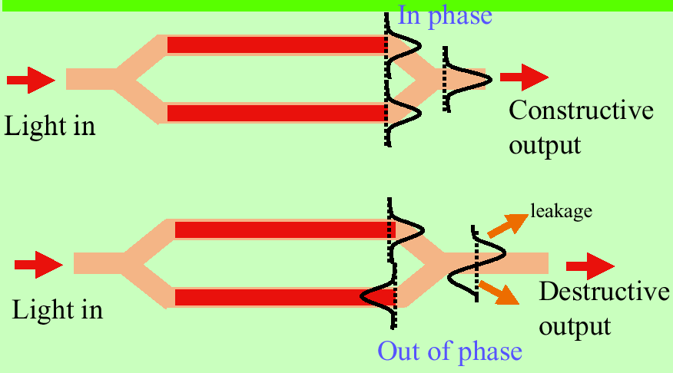

Slide 39
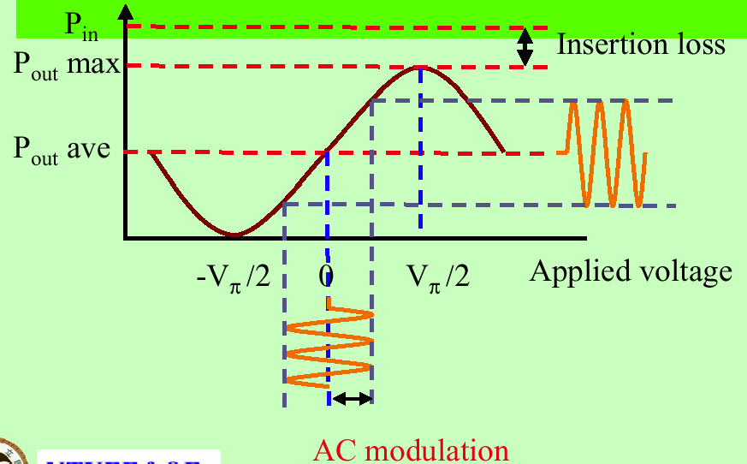

Slide 40
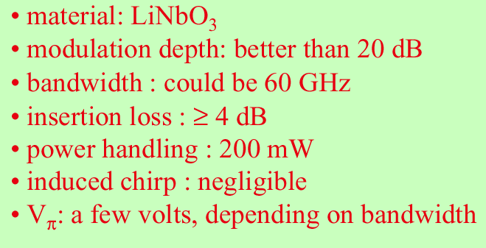
Characteristics of Mach- Zehnder modulator

Slide 41
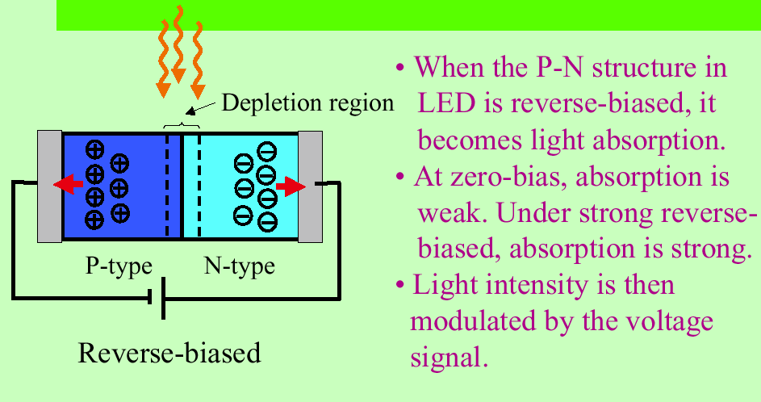
Electro- absorption (EA) modulator

Slide 42
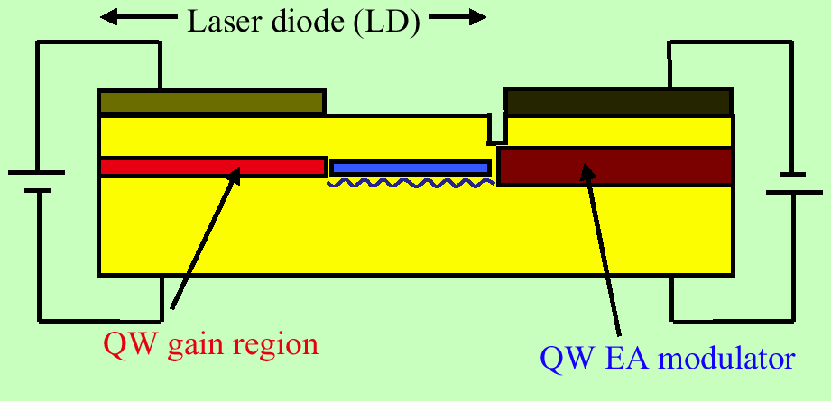
Integration of EA modulator with LD
Quantum well (QW) Laser: laser diode whose active region is so narrow that quantum confinement occurs

Slide 43
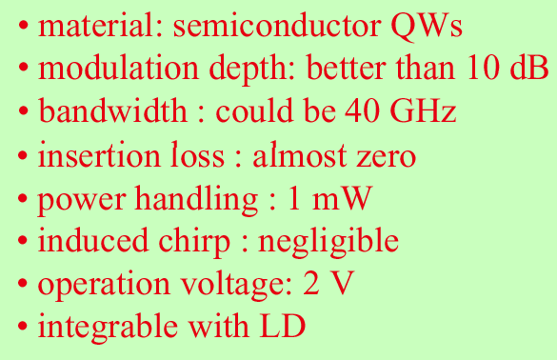
Characteristics of EA modulator

Slide 44
Laser and Optical Transmitter
Drive circuit
Photodiode
Repeater
Modulator
Amplifier
Fiber
Fiber
Light source
Decision device
Optical
Transmitter
electrical signal into optical signal
44

Slide 45
45
The principle of diode lasers
Fabry - Perot lasers (F-P LD)
Distributed feedback lasers (DFB LD)
Distributed Bragg reflector laser (DBR LD)
Quantum well lasers (QW LD)
Vertical cavity surface emitting lasers (VCSEL)
The characteristics of semiconductor lasers

Slide 46
Semiconductor laser (LD)
Laser is regarded as the three great inventions of twentieth Century (semiconductor and atomic energy). Especially, LD caught much attention.
Semiconductor lasers (LD) and light-emitting diode (LED) are the most common light sources.
The main difference:
The output of LED is non-coherent light;
The output of LD is coherent light.
46

Slide 47
LED
LED is the best light source for the communication systems, which are made of multi-mode fiber, require only a few tens of watts of input optical power, and the information bit rate is about 100 ~ 200Mb / s.
Compared with the semiconductor laser, LED doesn't need heat and light stabilizing circuit, so LED is relatively simple, and low cost.
47

Slide 48
LED
Spontaneous emission of light process is the mainly working principle of LED, which is a kind of non coherent light source.
LED has a wide spectrum, poor directionality and low response speed, is only used in the lower rate of a communication system.
In high-speed and large-capacity optical fiber communication systems, we mainly use semiconductor laser as the light source.
48

Slide 49
LD
Advantages: small size, high coupling efficiency, fast response, can be directly modulated, have a good coherence.
Classification by structure: F-P LD、 DFB LD、 DBR LD、 QW LD、 VCSEL
Classified by the guide mechanism: gain-guided LD and index-guided LD
Classification by performance: low-threshold LD, high speed LD, dynamic single-mode LD, high power LD
49

Slide 50
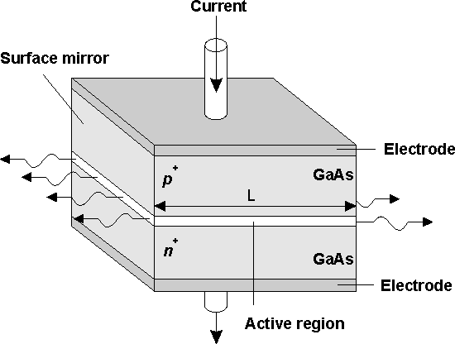
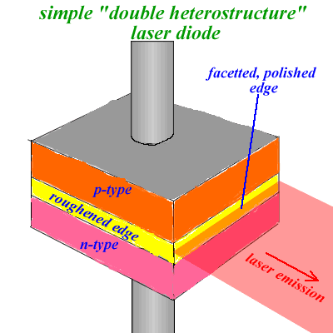
Fabry - Perot lasers (F-P LD)
F-P LD is the most common LD.
Consist of the epitaxial growth of the active layer and the active layer on both sides of the limiting layer. Resonant cavity is composed of two cleavage plane of crystal, usually are double heterostructure (DH) LD.
Laser is essentially a stimulated emission of light oscillation amplifier.
50

Slide 51
The basic principle of F-P LD
The four basic conditions of F-P LD:
The working substance to achieve electronic and optical field interacting
Pump source to inject energy (optical pump or electric pump)
An F-P resonator
To satisfy the condition of oscillation
51

Slide 52
1. Spontaneous emission, stimulated emission and stimulated absorption
The working substance and the pumping source is the most basic conditions of spontaneous emission, stimulated emission and stimulated absorption.
Spontaneous emission: Many in high energy particles respectively launch waves in a row whose frequency ν = (E2 -E1) /h, but there is no phase fixed relationship between the lights, and they can have different polarization directions, along all possible directions. The photons are independent of each other.
Stimulated emission: Particles at a high level of E2 when subjected to a light irradiation, will emit photons the same as incident, and transition to the lower energy level E1. The emission lights have the same direction of polarization and propagation direction.
52

Slide 53
Three kinds of transitions of two-level atom system
E₂
E₂
hν
hν
E₁
E₁
Spontaneous emission
Stimulated emission
E₂
Photons of stimulated emission have the same wavelength, phase, and direction of propagation with the original photon
hν
hν
hν
E₁
Stimulated absorption
53

Slide 54
The characteristics of spontaneous emission and stimulated emission
Spontaneous emission always occurs with stimulated emission.
In thermal equilibrium, spontaneous emission is larger than stimulated emission.
When the external energy to the system, such as light (i.e. light pump) or current injection (i.e. electric pump), the thermal equilibrium state is broken, and a large number of particles are at a high energy level, namely the population inversion. Stimulated emission is larger than spontaneous emission.
The first condition of laser emission:
The working substance (crystal materials which can achieve particle transition such as GaAs and InGaAsP)
External supply of energy to meet the population inversion (often using current injection)
54

Slide 55
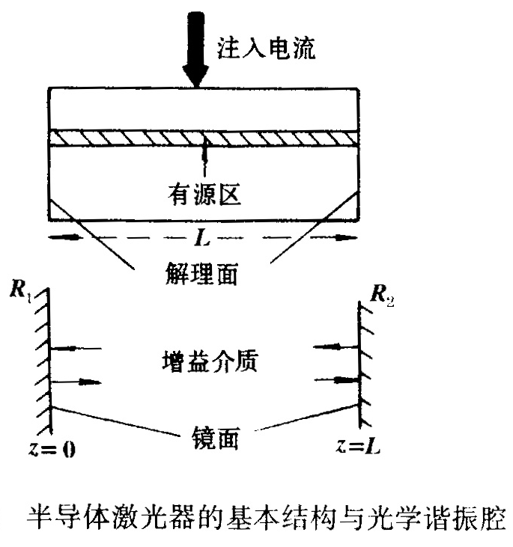
F-P cavity
The gain medium without optical feedback device can not form a laser.
F-P cavity: put the system which has already achieved population inversion distribution between a pair of mirrors placed strict parallel.
Light amplified during the process between the two mirrors.
55

Slide 56
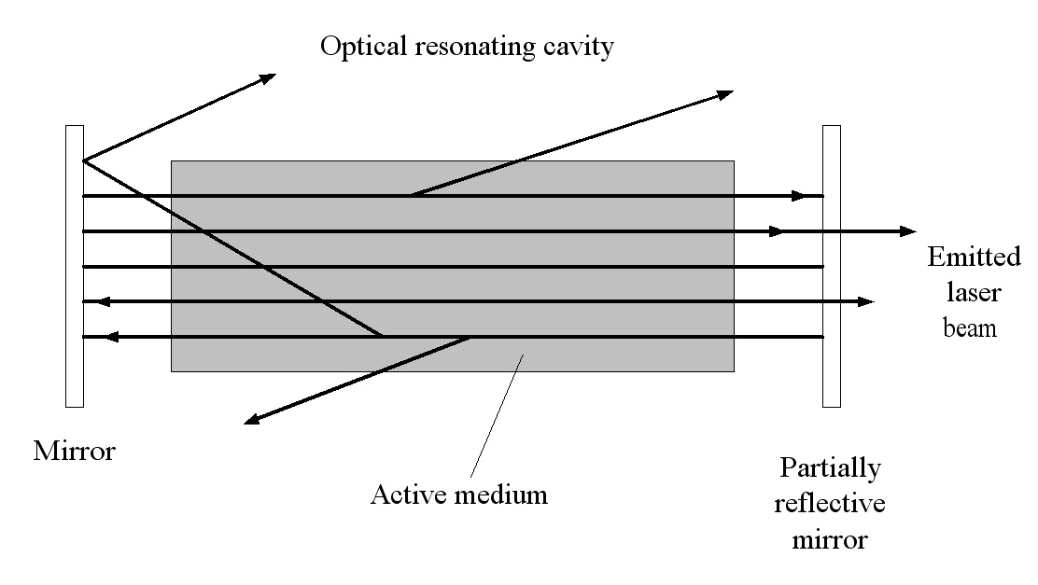
Oscillation condition
When the gain between the two mirrors exceeds the total loss, the resonant cavity selected the light of specific frequency, forming laser (coherent light).
Amplitude condition
Phase condition:
n-refractive index;
L-cavity length
m-arbitrary integer;
λ - wavelength
The frequencies meeting phase conditions is infinite. Only those frequencies around the center of spectrum can satisfy the amplitude condition. So the oscillation frequency of the laser can only take a finite number of values.
56

Slide 57
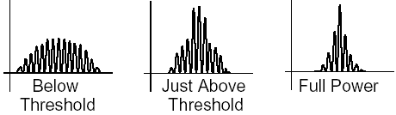
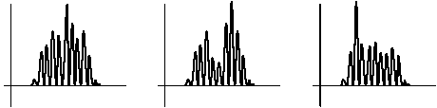
Output spectrum changes as power is applied
Typical mode hopping behavior
F-P LD in the condition of high-speed modulation, or the change of injection current and temperature, will appear mode jumping and spectral lines broadening. This is very adverse to high-speed applications. In order to maintain a single-mode, and reduce the spectral broadening, we need DFB LD and DBR LD.
57

Slide 58
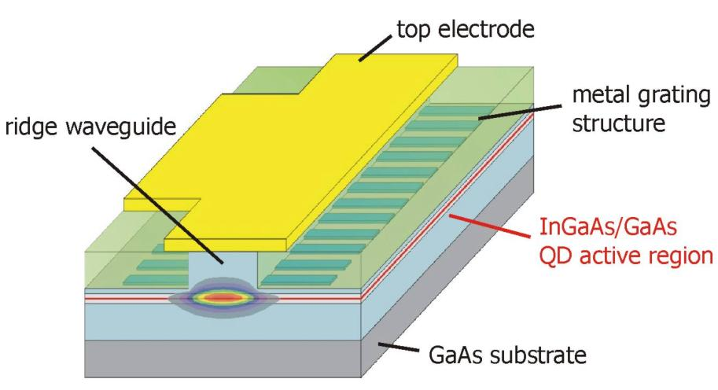
Distributed feedback lasers (DFB LD)
The main difference between DFB LD and F-P LD：DFB LD has no resonator mirror, and its reflection is provided by a Bragg grating in the active region of the waveguide.
Distributed feedback⇒good monochrome and direction
58

Slide 59
The basic principle of DFB LD
Using holographic lithography method to make periodic corrugation on the medium surface in active region.
Causing particle number inversion with the pump excitation.
Only the light wavelength meeting "Bragg reflection condition" can reflect back and forth in the medium, and be amplified.
DFB LD has become the major laser in long-distance transmission.
59

Slide 60
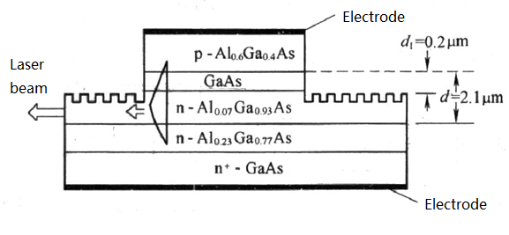
Distributed Bragg reflector laser (DBR LD)
Periodic grooves of DBR LD is in the two passive waveguide layer outside the active layer, this two grating waveguides play a role as Bragg reflector. Due to the active waveguide gain and Bragg reflection, only the light whose frequency near Bragg can meet the condition of oscillation.
GaAs/AlGaAs DBR
60

Slide 61
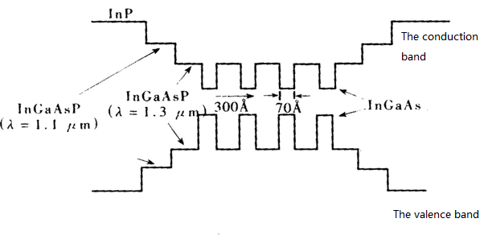
Quantum well lasers QW LD
The thin active region 1~10nm（FP cavity 100~200nm）
Periodic structure, the thin narrow band gap active region is sandwiched between the wide band gap semiconductor materials, forming potential energy wells.
Multiple quantum wells (MQW), Single quantum wells(SQW)
Characteristic:
Low threshold current
High output power
Narrow linewidth
Frequency chirp is improved
High modulation rate
The energy band diagram
61

Slide 62
Vertical cavity surface emitting lasers (VCSEL)
Vertical Cavity Surface Emitting Laser
Perpendicular to the substrate emitting laser
Advantages:
High luminous efficiency(850nm VCSEL,10mA drive,1.5mW output power)
The threshold is very low (Working current5~15mA)
Single-longitudinal mode and multi-longitudinal mode
High modulation rate
Long service life
Low prices, high yield
62

Slide 63
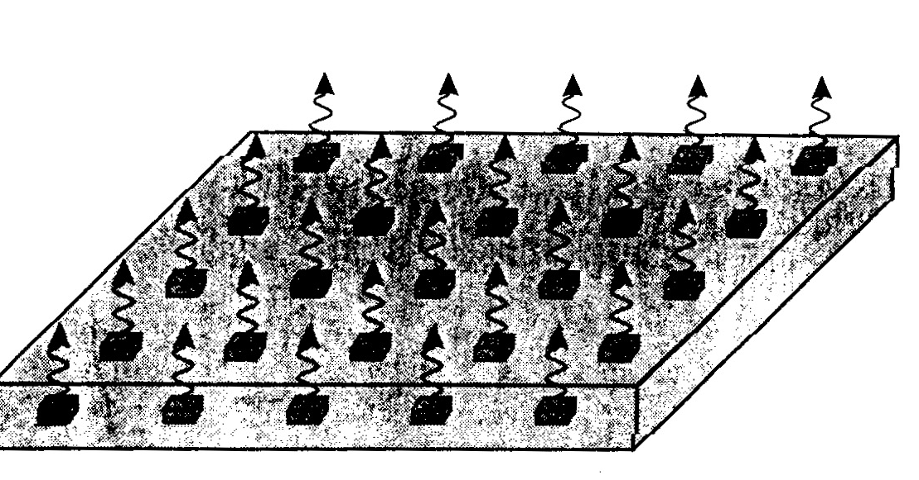
Can be arbitrarily in high-density two-dimensional laser arrays.
two-dimensional
laser arrays
63

Slide 64
Summary (1)
LD and LED are the most common light sources.
LED is simple, reliable, long life and so on. The process is spontaneous emission, so it's a non-coherent light source. For it's wide linewidth, poor directionality, and slow response speed, LED is only suitable for low rate communication systems.
LD are often used in high-speed large-capacity optical fiber communication system. LD is a kind of threshold device, only when the injection current reaches the threshold current, laser began to work.
LD must meet the following conditions：
Enough inversion distribution in active region；
A stable oscillation in the cavity。
64

Slide 65
Summary (2)
The transient properties of semiconductor lasers directly affect the quality of modulated optical signal;
In direct modulation, there are electro-optic delay and relaxation oscillation during the transient process；
The pattern effect will appear in high-speed digital modulation；
For th laser is very sensitive to the temperature and the thermal effect of current injection, the output will appear junction heating effect；
Some lasers will appear self-pulsation phenomenon;
In high-speed optical fiber communication systems, we often use external modulation. Because it is modulated after the laser is formed, it will not affect the spectral lines of the output.
65

